Slide 1
Data Warehousing - CS - 3
Mr. Atul Vaze
Certified BI Specialist(OBIEE)
Certified Agile Coach (ICP-ACC)
Function Point Specialist
Six Sigma GB

Slide 2
TOPICS
Data Mart
Enterprise Data Warehouse(EDW)
EDW Vs Data Marts
Concepts of data mart
Pros and Cons of taking data mart approach towards EDW
Decide suitable approach
Operational Data Store
Concepts of staging and OLAP
Desirable features for staging server and OLAP
Case study
Questions and Answers

Slide 3
Books
Text Books:
T1: Ponniah P, “Data Warehousing Fundamentals”, Wiley Student Edition, 2012
T2: Kimball R, “The Data Warehouse Toolkit”, 3e, John Wiley, 2013
Reference Books :
R1 : Anahory S, & Dennis M, “Data Warehousing in the Real World”, Pearson Education, 2008.
R2 : Kimball R, Reeves L, Ross M, & Thornthwaite, W, “The Data Warehouse Lifecycle Toolkit”, John Wiley, 2e, 2012.
R3: Jiawei Han, Micheline Kamber and Jian Pei, “Data Mining: Concepts and Techniques”, Morgan Kaufmann Publishers 2012
R4: Krish Krishnan, “Data Warehousing in the Age of Big Data”, Morgan Kaufmann Publishers 2013
Note: In order to broaden understanding of concepts as applied to Indian IT industry, students are advised to refer books of their choice and case-studies in their own organizations

Slide 4
Data Marts
What is a data mart?
Advantages and disadvantages of data marts
Issues with the development and management of data marts
By Atul Vaze

Slide 5
Data Marts
A subset of a data warehouse that supports the requirements of a particular department or business process
Characteristics include:
  Does not always contain detailed data unlike data warehouses
  More easily understood and navigated
  Can be dependent or independent

Slide 6
Reasons for Creating Data Marts
Proof of Concept for the DW
Can be developed quickly and less resource intensive than DW
To give users access to data they need to analyze most often
To improve query response time due to reduction in the volume of data to be accessed

Slide 7
Kimball vs Inmon
Bill Inmon: Endorses a Top-Down design
Independent data marts cannot comprise an effective EDW. Organizations must focus on building EDW
Ralph Kimball: Endorses a Bottom-Up design
EDW effectively grows up around many of the several independent data marts – such as for sales, inventory, or marketing

Slide 8
Kimball vs Inmon: War of Words
"...The data warehouse is nothing more than the union of all the data marts...,"
Ralph Kimball, December 29, 1997.
"You can catch all the minnows in the ocean and stack them together and they still do not make a whale,"
Bill Inmon, January 8, 1998.

Slide 9
Data Warehouse or Data Mart First?
Top-Down vs. Bottom-Up Approach
Advantages of Top-Down
  A truly corporate effort, an enterprise view of data
  Inherently architected-not a union of disparate DMs
  Central rules and control
  May be developed fast using iterative approach

Slide 10
Data Warehouse or Data Mart First?
(Top-Down vs. Bottom-Up Approach)
Top-Down Approach (DW →Data Mart)
Advantages of this approach are:
A truly corporate effort, an enterprise view of data
Inherently architected—not a union of disparate data marts
Single, central storage of data about the content
Centralized rules and control
May see quick results if implemented with iterations
Disadvantages are:
Takes longer to build even with an iterative method
High exposure/risk to failure
Needs high level of cross-functional skills
High outlay without proof of concept

Slide 11
Data Warehouse or Data Mart First?
(Top-Down vs. Bottom-Up Approach)
Bottom-Up Approach (Data Mart → DW)
Advantages of this approach are:
Faster and easier implementation of manageable pieces
Favorable return on investment(ROI) and proof of concept
Less risk of failure
Inherently incremental; can schedule important data marts first
Allows project team to learn and grow
Disadvantages are:
Each data mart has its own narrow view of data
Enters redundant data in every data mart
Maintains inconsistent and incompatible data
Grows unmanageable interfaces

Slide 12
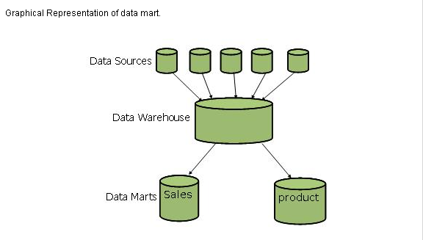
Graphical Representation of Data mart

Slide 13
EDW Vs Data Marts
Data Mart | Data Warehouse
Data collected for Analysis is based on single subject | Data collected for analysis is based on multiple subjects
Each subject area work independently | Integration is possible between various subjects
May hold more summarized data (although many hold full detail) | Hold very detailed information
Concentrates on integrating information from a given subject area or set of source systems | Works to integrate all data sources
It can be normalized | It is highly de-normalized
Is built focused on a dimensional model using a star schema. | Does not necessarily use a dimensional model but feeds dimensional models
Occupies less storage area | Occupies more storage area
Maintenance overhead is less | Maintenance overhead is more

Slide 14
EDW Vs Data Marts
Enterprise Data Warehouse (EDW): The enterprise data warehouse is typically a large organization-wide database repository that crosses over every business function and includes data from every organizational unit, division, and department. In essence, an enterprise data warehouse is a substantially large repository of historical and current transaction data of an entire organization.
As an implementation of an enterprise data warehouse is commonly strategic in nature, the volume of data in enterprise data warehouses tends to be quite large. Enterprise data warehouses can contain hundreds of gigabytes, terabytes, and sometimes even petabytes of data.
Data Mart: A data mart is a collection of subject areas organized for decision support based on the needs of a given department or office. Many times, a data mart will serve as the reporting and analytical solution for a particular department within an organization, such as accounting, sales, customer service, and/or marketing.
For the most part, data marts are designed with just enough data entities, fields, and records to satisfy one department’s requirements.

Slide 15
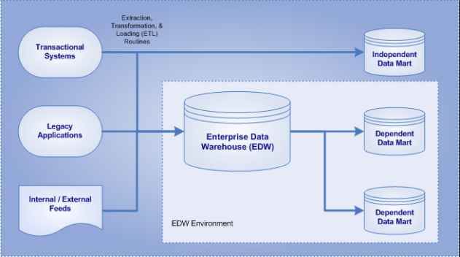
EDW Vs Data Marts
There are two kinds of data marts that exist — dependent and independent:
• A dependent data mart is one whose source is another data warehouse, and all dependent data marts within an organization are typically fed by the same source — the enterprise data warehouse.
• An independent data mart is one whose source is directly from transactional systems, legacy applications, or external data feeds.

Slide 16
Kimball vs. Inmon
There is no right or wrong between these two ideas, as they represent different data warehousing philosophies.
In reality, the data warehouse in most enterprises are closer to Ralph Kimball's idea.
This is because most data warehouses started out as a departmental effort, and hence they originated as a data mart.
Only when more data marts are built later do they evolve into a data warehouse.

Slide 17
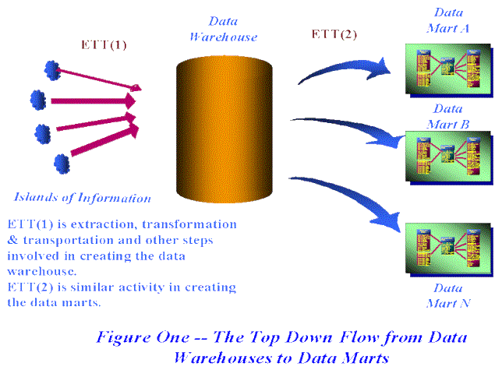
Dependent Data Marts

Slide 18
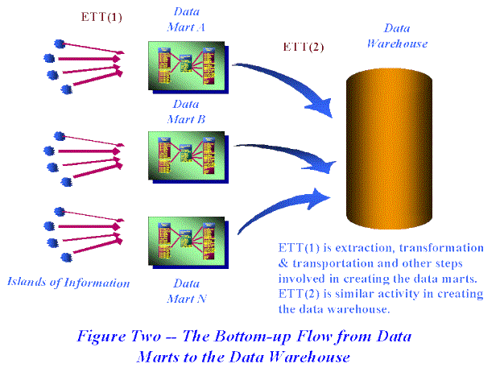
Independent Data Marts

Slide 19
Which approach is suitable for your data warehouse?
Inmon versus Kimball is one of the biggest data modelling debates among data warehouse architects.
In Bill Inmon’s enterprise data warehouse approach (the top-down design), a normalized data model is designed first, then the dimensional data marts, which contain data required for specific business processes or specific departments, are created from the data warehouse.
In Ralph Kimball’s dimensional design approach (the bottom-up design), the data marts facilitating reports and analysis are created first; these are then combined together to create a broad data warehouse.

Slide 20
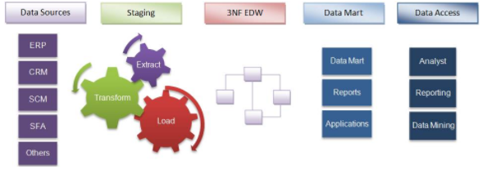
Which approach is suitable for your data warehouse?
Inmon’s top-down approach
Inmon defines a data warehouse as a centralised repository for the entire enterprise. A data warehouse stores the “atomic” data at the lowest level of detail. Dimensional data marts are created only after the complete data warehouse has been created. Thus, the data warehouse is at the center of the corporate information factory (CIF), which provides a logical framework for delivering business intelligence.

Slide 21
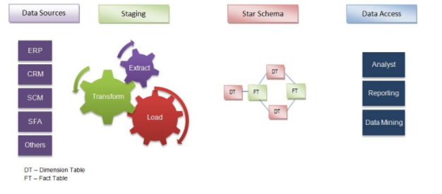
Which approach is suitable for your data warehouse?
Kimball’s bottom-up approach
Keeping in mind the most important business aspects or departments, data marts are created first. These provide a thin view into the organizational data and, as and when required, these can be combined into a larger data warehouse.
Kimball defines data warehouse as “a copy of transactional data specifically structured for query and analysis”.
Kimball’s data warehousing architecture is also known as data warehouse bus (BUS). Dimensional modelling focuses on ease of end-user accessibility and provides a high level of performance to the data warehouse

Slide 22
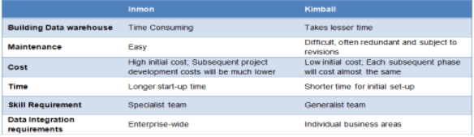
Pros and cons of both approaches

Slide 23
How to Decide?(1/2)
(with the suitable examples and case studies)
As we have already seen, the approach to designing a data warehouse depends on the business objectives of an organization, nature of business, time and cost involved, and the level of dependencies between various functions.
Inmon’s approach is suitable for stable businesses that can afford the time taken for design and the cost involved.
Also, with every changing business condition, they do not change the design; instead, they accommodate these into the existing model. However, if local optimization is good enough and the focus is on a quick win, it is advisable to go for Kimball’s approach.
Keeping this in mind, Let the Inmon versus Kimball fight happen over a few sectors/functions.
Insurance: It is vital to get the overall picture with respect to individual clients, groups, history of claims, mortality rate tendencies, demography, profitability of each plan and agents, and so on. All aspects are interrelated and therefore suited for the Inmon approach.

Slide 24
How to Decide?(2/2)
(with the suitable examples and case studies)
Marketing: This is a specialized division that does not call for enterprise warehouse. Only data marts are required, so Kimball’s approach is suitable.
CRM in banks: The focus is on parameters such as products sold, up-sell and cross-sell at a customer level. It is not necessary to get an overall picture of the business.
  For example, there is no need to link a customer’s details to the treasury department dealing with forex transactions and regulations. Because the scope is limited, you can go for Kimball’s method. However, if the entire processes and divisions in the bank are to be linked, the obvious choice is Inmon’s design versus Kimball’s.
Manufacturing: Multiple functions are involved here, irrespective of the budget involved. Therefore, where there is a systemic dependency, as in this case, an enterprise model is required, so Inmon’s method is ideal.

Slide 25
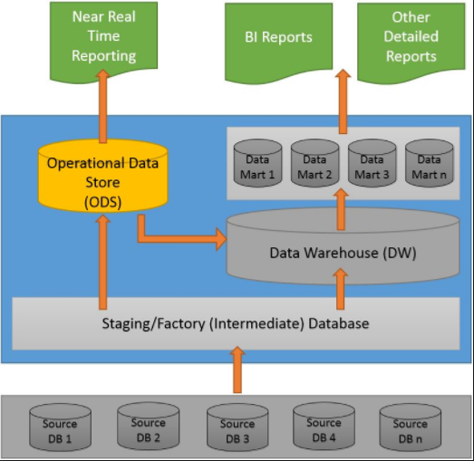
Operational Data Store(ODS)
An operational data store (ODS) is a type of database often used as an interim area for a data warehouse.
ODS Is highly volatile
An ODS is designed to quickly perform relatively simple queries on small amounts of data (such as finding the status of a customer order)
An ODS is similar to your short term memory in that it stores only very recent information; in comparison, the data warehouse is more like long term memory in that it stores relatively permanent information.

Slide 26
ODS
According to Inmon, an ODS is a "subject-oriented, integrated, volatile, current valued data store, designed to serve operational users as they do high performance integrated processing.
In the early 1990s, the original ODS systems were developed as a reporting tool for administrative purposes

Slide 27
ODS
Subject-oriented
    Customer, product, account, vendor etc.
Integrated
    Data is cleansed, standardized and placed into a consistent data model
Volatile
    UPDATEs occur regularly, whereas data warehouses are refreshed via INSERTs to firmly preserve history
Current valued
    Changes are made almost with zero latency

Slide 28
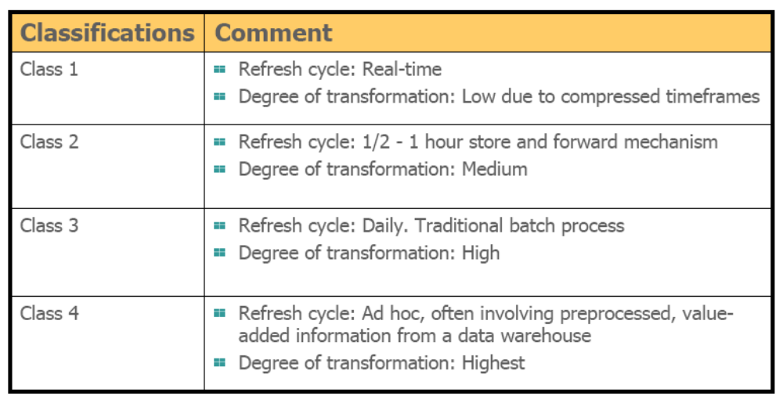
Classification of ODS

Slide 29
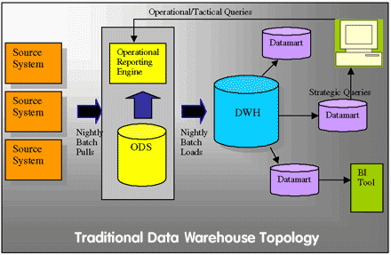
ODS

Slide 30
ODS & Real-Time Data Warehousing
Which class of ODS can be used for RTDWH?
HOW?
Let us first look at what we mean by RTDWH
Wait till we talk about RTDWH

Slide 31
Data Staging Area(DSA)
A staging area, or landing zone, is an intermediate storage area used for data processing during the extract, transform and load (ETL) process. The data staging area sits between the data source(s) and the data target(s), which are often data warehouses, data marts, or other data repositories
A storage area where extracted data is
    Cleaned
    Transformed
    De-duplicated
Initial storage for data
Need not be based on Relational model
Spread over a number of machines
Mainly sorting and Sequential processing
COBOL or C code running against flat files
Does not provide data access to users

Slide 32
Data Staging Area
The Data Warehouse Staging Area is temporary location where data from source systems is copied
Due to:
  varying business cycles
  data processing cycles
  hardware and network resource limitations and
  geographical factors
  it is not feasible to extract all the data from all Operational databases at exactly the same time
For example: Data from Singapore branch will arrive much earlier than from the NY branch

Slide 33
Data Staging Area
Simplifies the overall management of a Data Warehousing system
ETL tools work here!
DSA is everything between the source systems and the presentation server
Raw food (read data) is transformed into a fine meal (read data fit for user queries and consumption)
DSA is accessible only to professional chefs (read skilled professionals)
Customers (read end users) are not invited to eat in the kitchen (query in the DSA)

Slide 34
Data Staging Area
Key architectural requirement for the DSA is that it is Off-limits to business users and does not provide query and presentation services

Slide 35
Data Staging Area
Steps involved:
  Extraction
  Transformation
    Cleansing the data
    Combining data from multiple sources
    Deduplicating data
    Assigning Surrogate keys
  Load or Transfer

Slide 36
Data Staging Area
DSA is dominated by sorting and sequential processing
DSA is not typically based on the relational model, but rather a collection of flat files
Many times the data arrives in the DSA in 3rd normal form, which is acceptable
But, is not recommended because the data has to be loaded into the presentation server in the dimensional model
Normalized database in the staging area is acceptable for supporting the staging process but must be off-limits to user queries as they defeat understandability and performance

Slide 37
Presentation Server
A target physical machine on which DW data is organized for
    Direct querying by end users using OLAP
    Report writers
    Data Visualization tools
    Data mining tools
Data stored in Dimensional framework
Presentation area is the DW for the end users
Analogy – Sitting area of a restaurant

Slide 38
Presentation Server
In Kimball’s approach, presentation area is a series of integrated data marts (super marts)
A data mart is a piece of the overall presentation area pie
Data is presented, stored, and accessed in dimensional schema
Dimensional modeling is very different from 3NF modeling (normalized models)
Normalized modeling is quite useful in OLTP systems
  Not suitable for DW queries!!

Slide 39
Presentation Server
Data Marts must contain detailed and atomic data
May also contain aggregated data
All Data Marts be built using common dimensions and facts
  Conformed dimensions and facts
Concept of SUPERMARTS!!

Slide 40
Presentation Server
Data Warehouse Bus Architecture
Building a DW in step is too daunting a task
Architected, incremental approach to building a DW is the DW Bus Architecture
Define a standard bus for the DW environment
Separate data marts, developed by different groups at different times, can be plugged together and can usefully coexist if they conform to the standard

Slide 41
Presentation Server
According to Kimball –
“Data in the queryable presentation area of the DW must be dimensional, must be atomic, and must adhere to the data warehouse bus architecture”

Slide 42
Data Access Tools
Data access tools query the data in the presentation area of the DW
OLAP (On-Line Analytical Processing)

Slide 43

OLAP
What is OLAP
Need for OLAP
Features & functions of OLAP
Different OLAP models
OLAP implementations

Slide 44
OLAP
Term coined in mid 1990s
Main Goal: support ad-hoc but complex querying by business analysts
Extends worksheet like analysis to work with huge amounts of data in a DW

Slide 45
Demand for OLAP
Need for Multidimensional Analysis
Fast Access & Powerful Calculations
Limitations of other analysis methods like:
  SQL
  Spreadsheets
  Report Writers

Slide 46
OLAP is the Answer!
  OLAP is a category of software technology that enables analysts, managers, and executives to gain insight into the data through fast, consistent, interactive, access in a wide variety of possible views of information that has been transformed from raw data to reflect the real dimensionality of the enterprise as understood by the user.

Slide 47
What is OLAP?
OLAP software provides the ability to analyze large volumes of information to improve decision making at all levels of an organization.
Prof. Navneet Goyal, BITS Pilani

Slide 48
What is OLAP?
  A wide spectrum of multidimensional analysis involving intricate calculations and requiring fast response times.

Slide 49
What is OLAP?
  OLAP has two immediate consequences: online part requires the answers of queries to be fast, the analytical part is a hint that the queries itself are complex
  i.e., Complex questions with Fast Answers!
Prof. Navneet Goyal, BITS Pilani

Slide 50
Why a separate OLAP tool?
  Empowers end users to do own analysis
  Frees up IS backlog of report requests
  Ease of use
  No knowledge of tables or SQL required

Slide 51
OLAP Characteristics
Multi-user environment
Client-server architecture
Rapid response to queries, regardless of DB size and complexity

Slide 52
Data Warehouse & OLAP
OLAP is a software system that works on top of a DW
A front-end tool for a DW
Information delivery system for the DW
Compliments the information delivery capacities of a DW

Slide 53
Why is OLAP useful?
Facilitates multidimensional data analysis by pre-computing aggregates across many sets of dimensions
Provides for:
  Greater speed and responsiveness
  Improved user interactivity

Slide 54
Warehouse Models & Operators
Data Models
  relations
  stars & snowflakes
  cubes
Operators
  slice & dice
  roll-up, drill down
  pivoting
  other

Slide 55
The Complete Picture
Source Systems
Data Staging Area
Presentation Servers
Data Mart/Super Marts
Data Warehouse
Operational Data Store
Data Access Tools
Need to understand the interconnect between the above elements of a Data Warehouse System

Slide 56
Questions
Describe the best practices to implement a Data Warehouse
Why we need Data Warehouse?
Describe what types of processing take place in a data warehouse?
Whether to build the data warehouse first or the data mart first.”
DATA WAREHOUSES AND DATA MARTS: How are they different?
Top-Down Versus Bottom-Up Approach and which approach is suitable for your data warehouse?
Explain pros and cons of taking data mart approach towards EDW (Bottom Up Approach)
What is staging area in DW and why it is needed? Explain components of DW
Why are operational systems not suitable for providing strategic information? Give 2-3 specific reasons and explain.

Slide 57
Thank You
Any Questions?

